Slide 1

Extracting Features from and Standardizing Phoneme Features
Mezisashe Ojuba
16th July 2024.

Slide 2
Methodology
I got the features from the entire TIMIT training dataset
I found the weighted average length of features
I visualized features for phonemes using umap and matplotlib.
Standardize features using Zmuv normalization.
Look at the difference in pattern between normalized and un-normalized features.

Slide 3
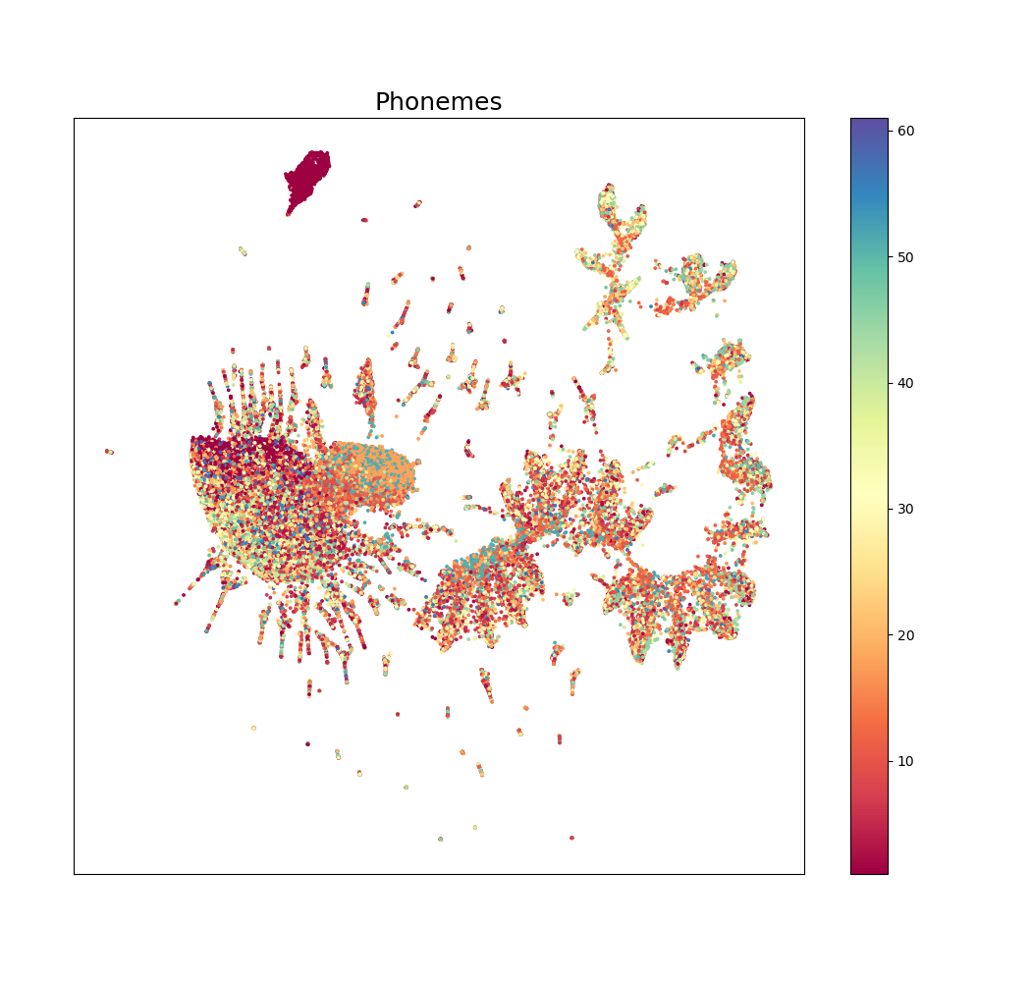
Visualized before normalization and grouped according to each phoneme class

Slide 4
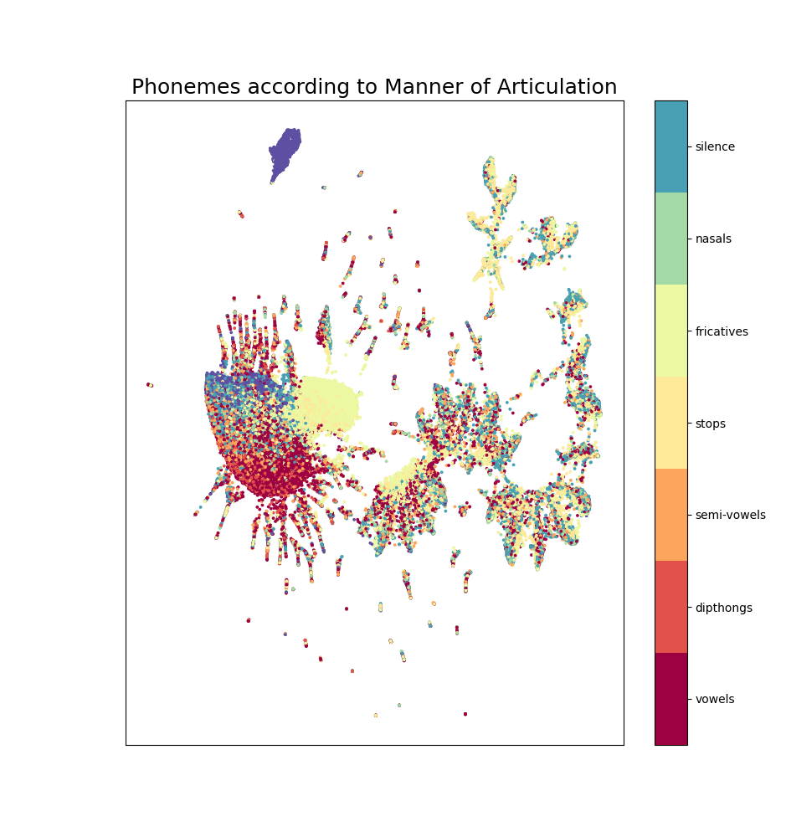
Visualized before normalization and grouped according to manner of articulation [1]

Slide 5
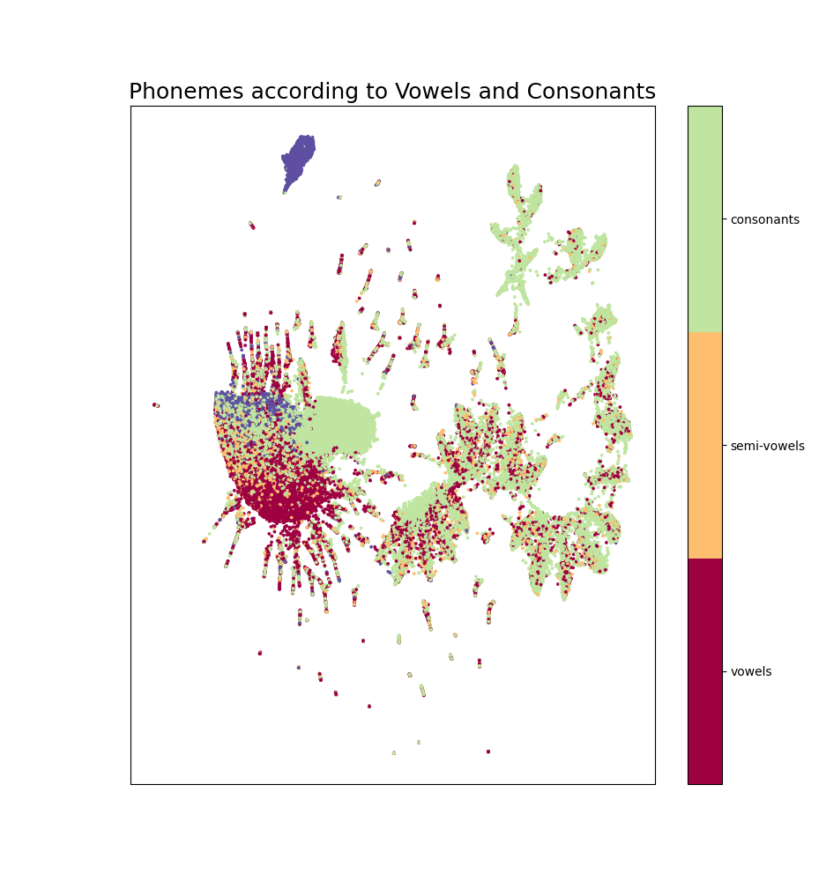
Visualized before normalization and grouped according to vowels/consonants

Slide 6
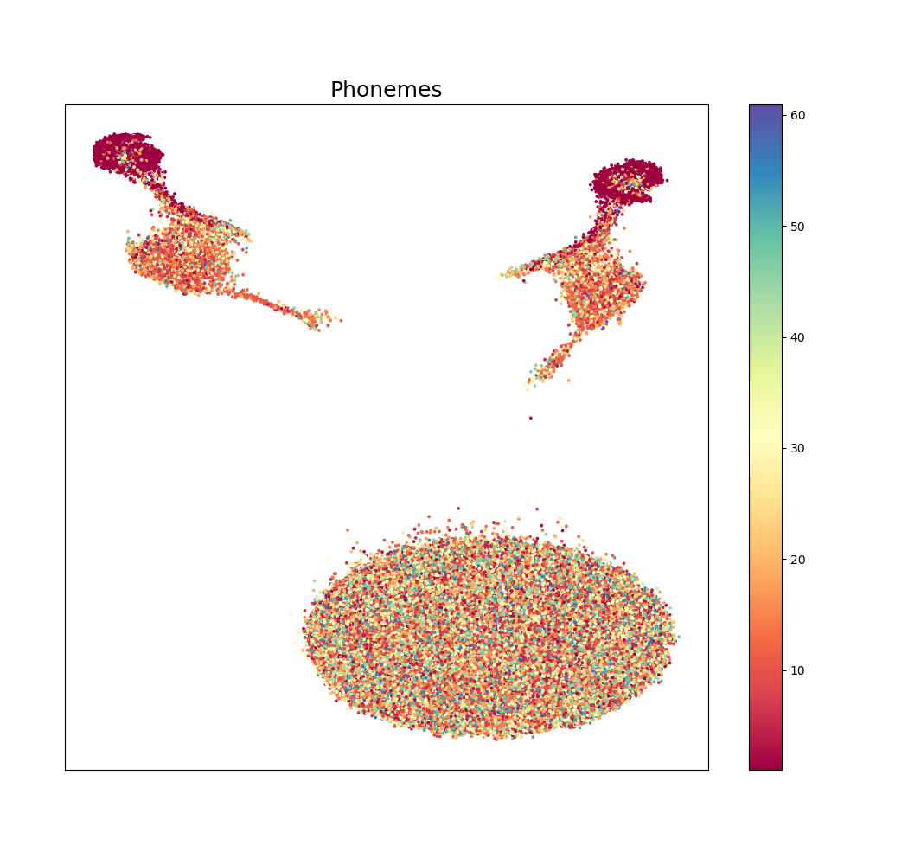
Visualized after normalization and grouped according to each phoneme class

Slide 7
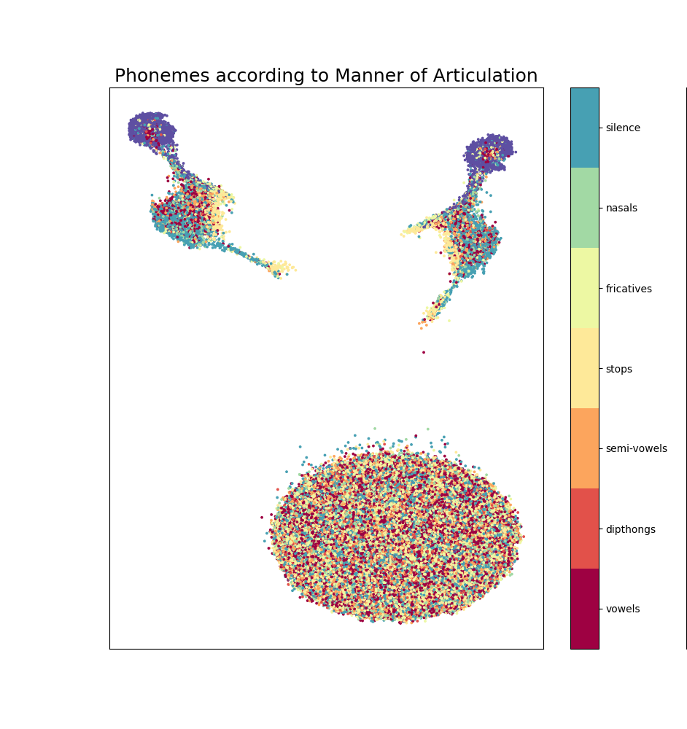
Visualized after normalization and grouped according to manner of articulation [1]

Slide 8
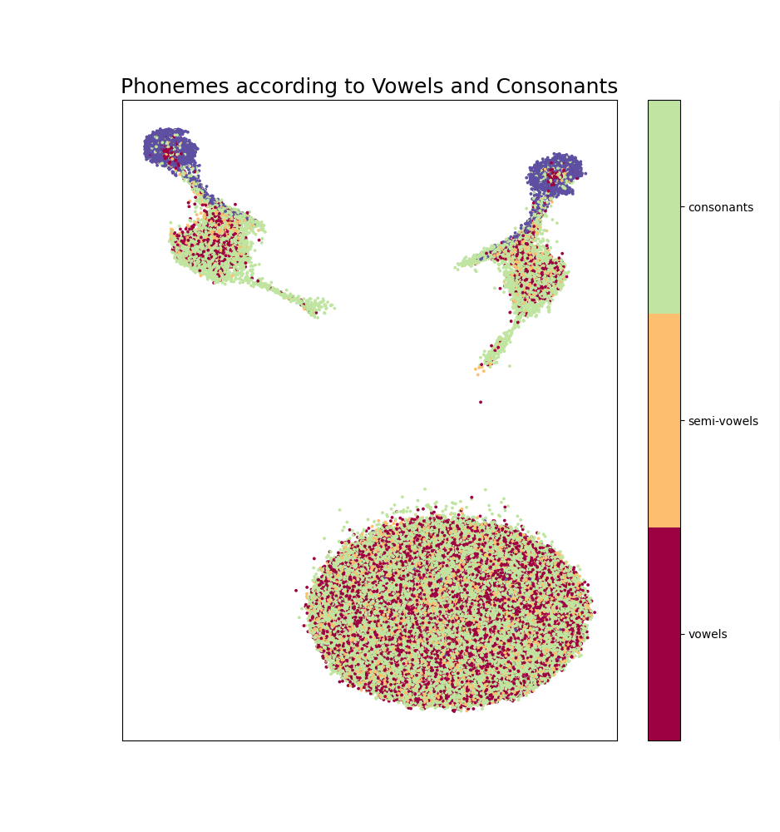
Visualized after normalization and grouped according to vowels and consonants

Slide 9
Results
The features cluster more visibly (according to manner of articulation or vowel/consonant) before normalization than after.

Slide 10
Next Steps
Fine tune Kevin’s saved model using normalized features

Slide 11
References
[1] https://ieeexplore.ieee.org/stamp/stamp.jsp?tp=&arnumber=4100697

